Slide 1
Water Pollution –II
Centre for Environmental Science and Engineering
IIT Bombay

Slide 2
Eutrophication - Solutions
  Wastewater treatment-?
  Limit your fertilizer use and apply at appropriate times
  Control runoff and soil erosion
  Start a compost pile and recycle yard waste
  Conserve water and energy
  Plant trees and other deep root plants

Slide 3
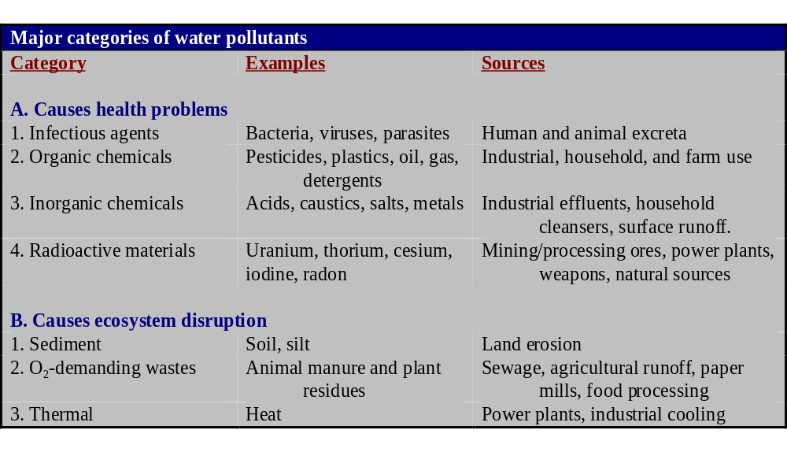
Pesticides-Metals-Plastic-POPs recent origin- Treatment?

Slide 4
Water Pollution Control
Point Source: discharge of pollutants from single point.
Factories, power plants, sewage treatment plants, oil wells.
Non-point Source: sources of water pollution that are scattered or diffuse, not having a specific location. Farm fields, golf courses, lawns, cities, roads, clearcut forests, mines
Reduce the sources of water pollution

Slide 5
WWT Physical, Chemical, Biological, Advanced WWT
    Primary treatment: physical separation of solids
    Secondary treatment: aeration tank, biodegradation
    Tertiary treatment: remove phosphates/nitrates lagoon/marsh or trickling filter.
    Bioremediation: use of organisms to remove water pollutants
    Biological Wastewater Treatment - Conventional
    Attached growth (ASP)- Suspended growth (TF, RBC)
    Aerobic (ASP) – Anaerobic (UASB)
    Alternative
    Stabilization/Oxidation Ponds, Constructed Wetlands
    Anaerobic Processes

Slide 6
Are Conventional Methods of WW treatment suitable for India
Waste Stabilization Ponds
Artificial wet lands
Anaerobic WWT
UASB
Eucalyptus plantation

Slide 7
Conventional v/s Ecological
Conventional wastewater treatment
  Removing
    Organic compounds
    Nitrogen
    Phosphorus
    Other toxic constituents
  Costly + no economic gains
  High consumption in non-renewable energy
Resource Recycling
  Removing
    Pathogens
    Other toxic constituents
  But, to transform valuable resources into “reclaimable products”
    Organic compounds
    Nitrogen
    Phosphorus
  Less costly + potential benefit
  Environmental friendly

Slide 8
Alternatives for Resource Recycling
Direct application
  Agriculture
    Farmland
    Land reclamation
    Composting
  Aquaculture
    Fish production
    Algae/Duckweed production
Indirect application
  Biogas production
    Anaerobic processes
  Indirect reuse
    Discharge into receiving steams (Indonesia)
Integrated approaches
  C to produce biogas & N, P to reclaimed or removed
    Biogas + ponds
    Biogas + wetlands
  C to be biodegraded & N, P to grow vegetables, fish or aquatic plants
    Ponds + agriculture
    Ponds + aquaculture
    Ponds + wetlands

Slide 9
Pond Treatment Systems
Waste stabilization ponds
  Are earthen basins contain a relatively shallow water body
  Employ algal-bacterial symbiotic interactions
    Algae to provide oxygen
    Bacteria to degrade organics
  Can be classified into
    Aerobic, facultative, anaerobic
    Depending on water depth + loading
  Proving high effluent quality in treating wastewater from
    Domestic, agriculture and industries
  Require low investment and operational costs but require relatively large area

Slide 10
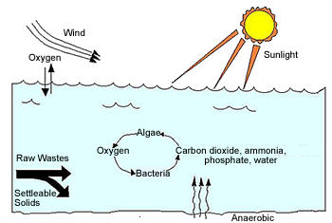
Stabilization Ponds
Bacteria and other heterotrophs convert organic matter to carbon dioxide, inorganic nutrients, water and microbial biomass.
Algae use CO₂ and inorganic nutrients, primarily N and P, in photosynthesis to produce oxygen and algal biomass.

Slide 11
Mechanism of Purification
Aerobic Layer:
  Oxygen supplied by algal photosynthesis.
  Non-settleable and dissolved organic matter oxidized to CO₂ and H₂O.
  End-products of anaerobic decomposition (VFA, alcohols) oxidized aerobically.
  Algae takes up stable end-products (CO₂, NO₃₋ and PO₄₋), produce oxygen.
Anaerobic Layer:
  Settled sludge from raw waste and microbial synthesis undergoes stabilization (converted to methane).

Slide 12
Mechanisms of Purification …cont’d
Depth of aerobic and anaerobic zones
  Function of solar radiation, waste characteristics, loading and temperature.
Diurnal(daily) Variations
Odour Control
Algae

Slide 13
Types of Stabilization Ponds
Aerobic ponds: Used as additional treatment processes (Polishing Pond).
  Depth < 0.5 m
  BOD loadings: 40-120 kg/ha.d
Anaerobic Ponds: Deep ponds with very thin aerobic surface layer.
  Used for high strength industrial wastes, digestion of municipal sludges.
  BOD loadings: 400-300 kg/ha.d
  Detention period: 5-50 days
  BOD reduction: 50-85 %
  Should be followed by aerobic end treatment.
Facultative ponds: Both aerobic and anaerobic zones exist.
  Aerobic at surface and anaerobic at bottom

Slide 14
Lagoons
Difference: Oxygen provided by artificial aeration.
Aerated Lagoons: Entire contents including the sewage solids are mixed and aerated.
  Effluent required solid removal.
Facultative Lagoon: Only liquid portion is mixed.
  Solids settle to bottom and degrade anaerobically.

Slide 15
Typical Design Parameters
Parameter | Facultative Pond | Facultative Lagoon
Detention Time, days |  | 3-5
Depth, m | 1.0 – 1.5 m | 2.5 - 5.0
Organic loading, kg BOD₅/ha.d | 150 -325
Land required, m²/person |  | 0.15 - 0.30
BOD Removal Efficiency, % | 80 – 90 | 80 – 90
Overall BOD removal rate (k), /day | 0.05 – 0.3 | 0.6 – 0.8
Desirable power level, watts/m³ |  | 0.75
Adapted from: CPHEEO Sewerage Manual, 1993

Slide 16
Construction Details
Site Selection
  Away from habitations.
  Downhill of ground water supply source.
  Should not be liable to flooding.
Pretreatment
  Medium screens, grit removal devices.
Arrangement of multiple units
  Parallel: facilitate maintenance, better distribution of settled solids.
  Series: better BOD and coliform removal, reduced algal effluent concentrations.
  Parallel-Series: advantages of both series and parallel systems.

Slide 17
Construction Details
Pond Shape
  No narrow or elongated portions (L = 3B).
  Rounded corners to avoid dead pockets.
Embankments
Pond Bottom
  Cleared of vegetation.
  Impervious bottom soil.
Pond inlets/outlets
  Avoid short-circuiting.
  For large ponds, multiple inlets/outlets to be provided.

Slide 18
Construction Details …cont’d
Pond Interconnections
  Provided in multiple cell series.

Slide 19
Applications
Advantages:
  Simple and cheap to construct.
  Doesn’t require skilled operation.
  Easy to maintain.
  If properly designed, provides effective treatment.
  Effluent may be used for pisiculture.
Disadvantages:
  Large land requirements.
  Requires bottom lining.
  Offensive odours may occur.

Slide 20
Aquaculture Ponds
Wastewater-fed earthen basins growing with algae+fish (or aquatic animals)
  Due to difficulties in algal harvesting → use fish to consume
  Algae →O₂ for fish and bacteria
  Bacteria →CO₂ for algal photosynthesis + degrade organic pollutants
Types
  Polyculture pond
    > 1 species
    Higher yield
  Monoculture pond
    Only 1 species + supplementary feeds
  Species
    Herbivorous -Silver carp, Grass carp
    Omnivorous – Tilapia, Chinese carp
    Carnivorous - Snakehead

Slide 21
WETLANDS
AN AREA THAT IS INUNDATED OR SATURATED BY SUFACE OR GROUNDWATER AT A FREQUENCY, DURATION AND DEPTH, SUFFICIENT TO SUPPORT A PREDOMINANCE OF PLANT SPECIES ADOPTED TO GROWTH IN SATURATED SOIL CONDITIONS
THEY HAVE A NATURAL ABILITY TO REMOVE POLLUTANTS FROM WATER BY VARIOUS BIOLOGICAL, CHEMICAL AND PHYSICAL PROCESSES THAT OCCUR WITHIN THESE ECOSYSTEMS

Slide 22
NATURAL WETLAND
UPLAND WETLAND AQUATIC
HIGH WATER TABLE
LOW WATER TABLE
HIGH WATER
LOW WATER
SEASONALLY
SATURATED SOILS
SEASONALLY
FLOODED SOILS
“TRANSITIONAL AREAS BETWEEN UPLANDS, WHERE EXCESSIVE
WATER IS NOT A FACTOR FOR PLANT GROWYH, & AQUATIC ECOSYSTEMS
WHERE FLOODING EXCLUDES ROOTED EMERGENT VEGETATION”

Slide 23
CONSTRUCTED WETLANDS
A “CONSTRUCTED WETLAND” IS DEFINED AS A WETLAND SPECIFICALLY CONSTRUCTED FOR THE PURPOSE OF POLLUTION CONTROL AND WASTE MANAGEMENT, AT A LOCATION OTHER THAN EXISTING NATURAL WETLANDS”

Slide 24
COMPONENTS OF A WETLAND
EMERGENT VEGETATION
DETRITUS
WATER
HYDRIC SOIL
UNDERLYING STRATA

Slide 25
FUNCTIONS: MACROPHYTES IN CONSTRUCTED WETLANDS
AERIAL PLANT TISSUE – ATTENUATE LIGHT, INSULATE DURING WINTER, REDUCE WIND VELOCITY, STORE NUTRIENTS
SUBMERSED PLANT TISSUE – FILTERING AFFECT, SURFACE AREA FOR BIO-FILM ATTACHMENT, NUTRIENT UPTAKE.
ROOTS AND RHIZOMES- STABILIZE SEDIMENTS, RELEASE OXYGEN, NITRIFICATION, NUTRIENT UPTAKE, ANTIBIOTIC RELEASE

Slide 26
REMOVAL PROCESSES
MOST PROCESSES ARE ENHANCED BY VEGETATION
PROCESSES INCLUDE:
  PHYSICAL
  CHEMICAL
  BIOLOGICAL

Slide 27
PHYSICAL
CHEMICAL
SEDIMENTATION
FILTRATION
ADSORPTION
PRECIPITATION
ADSORPTION
DECOMPOSITION
BIOLOGICAL
BACTERIAL METABOLISM
PLANT METABOLISM
PLANT ADSORPTION
NATURAL DIE-OFF

Slide 28
TREATMENT AND CONCERNS
BOD
TSS
NITROGEN
PHOSPHORUS
PATHOGENS
METALS AND ORGANIC CONTAMINANTS

Slide 29
BOD REMOVAL
SEDIMENTATION/ FILTRATION
BIOLOGICAL DEGRADATION- ATTACHED AND SUSPENDED GROWTH
MICROBIAL UPTAKE – LESS AS COMPARED TO BIOLOGICAL DEGRADATION

Slide 30
NITROGEN REMOVAL
PLANT UPTAKE
ADSORPTION
AMMONIA VOLATILIZATION
AMMONIFICATION
NITRIFICATION/ DENITRIFICATION

Slide 31
PHOSPHORUS REMOVAL
SEDIMENTATION OF PARTICLES
SOIL SORPTION
LITTER FALL
FILTRATION
PLANT AND MICROBIAL UPTAKE

Slide 32
PATHOGENS REMOVAL
NATURAL DIE OFF
SEDIMENTATION
FILTRATION
PREDATION
UV DEGRADATION
ADSORPTION

Slide 33
METAL REMOVAL
ADSORPTION AND CATION EXCHANGE
MICROBIACALLY MEDIATED PROCESSES
FILTRATION
PLANT UPTAKE

Slide 34
TYPES OF CONSTRUCTED WETLANDS
FREE SURFACE FLOW WETLANDS (FWS)
  SIMILAR TO NATURAL WETLANDS
  FREE FLOATING, EMERGENT, AND SUBMERGED PLANTS ARE USED
SUBSURFACE FLOW WETLANDS (SSF)
  WATER FLOWS BELOW SURFACE OF SUPPORT MEDIA
  EMERGENT PLANTS THAT ARE TOLERANT OF WATER SATURATED SOILS ARE USED

Slide 35
FWS WETLAND CONTAINING
EMERGENT MACROPHYTES
DISTRIBUTION PIPE
OUTLET WEIR
LOW PERMEABILITY SOIL
PLANTS SPECIES : BULRUSHED, COMMON EED

Slide 36
FWS WETLAND CONTAINING
FLOATING PLANTS
DISTRIBUTION PIPE
OUTLET WEIR
LINED BASIN
PLANTS SPECIES: WATER HYACINTH, DUCKWEED

Slide 37
FWS WETLAND CONTAINING
ROOTED, FLOATING LEAF PLANTS
DISTRIBUTION PIPE
OUTLET WEIR
LINED BASIN
PLANTS SPECIES : WATER LILIES, LOTUS

Slide 38
FWS WETLAND WITH A
FLOATING EMERGENT MACROPHYTE MAT
DISTRIBUTION PIPE
OUTLET WEIR
LOW PERMEABILITY SOIL
PLANTS SPECIES : CATTAILS, GIANT SWEETGRASS

Slide 39
FWS WETLAND CONTAINING
SUBMERGED MACROPHYTES
OUTLET WEIR
DISTRIBUTION PIPE
LOW PERMEABILITY SOIL
PLANTS SPECIES : WATERWEED, WATER MILFOIL

Slide 40
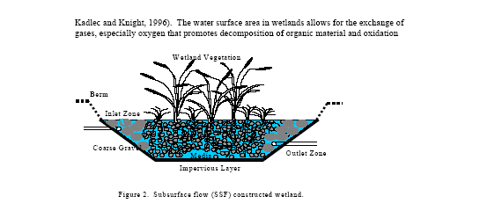
SUBSURFACE FLOW
CONSTRUCTED WETLAND
WETLAND VEGETATION
BERM
INLET ZONE
COARSE GRAVEL
OUTLET ZONE
IMPERVIOUS LAYER
PLANTS SPECIES :SWEET MANNAGRASS, COMMON REED

Slide 41
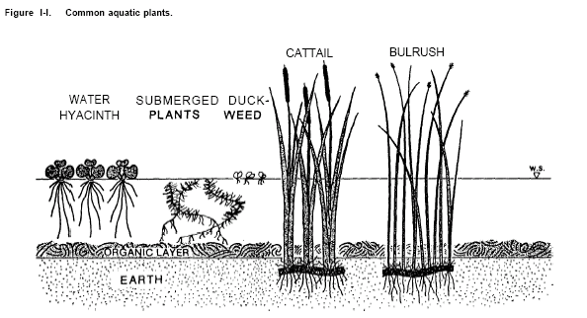
COMMON AQUATIC PLANTS

Slide 42
DESIGN PARAMETERS
HYDRAULIC SIZE -------- FLOW RATE, OUTLET WEIR SETTLING, ASPECT RATIO, BOTTOM SLOPE AND VEGETATION RESISTANCE
WETLAND SIZE ------ EXISTING TOPOGRAPHY, GEOLOGIC FEATURES ----- OVERALL ECONOMY
BOUNDARIES ----- ROADS, NEIGHBOURING PROPERTIES, SURFACE WATER BODIES
NUMBER OF CELLS ------GUARD AGAINST SYSTEM FAILURES SUCH AS VEGETATION DIE-OFF, BERM OR OTHER STRUCTURE DAMAGE OR PRETREATMENT SYSTEM FAILURE.

Slide 43
SPECIFIC DESIGN PARAMETERS
PONDED ZONES ------- UNVEGETATED AND PROVIDE FLOW STABILIZATION OR CONSTANT HEAD ACROSS THE WETLAND. THEY EXTEND DETENTION TIMES AND ALSO PROVIDE A CHANGE IN HABITAT WITHIN THE WETLAND
LINERS -------- PREVENTS INTERACTION WITH GROUNDWATER. BENTONITE IS COMMONLY USED AS A CLAY LINER MATERIAL. SYNTHETIC LINERS CAN ALSO BE USED AND MUST BE THICK ENOUGH TO PREVENT ROOT PENETRATION AND RODENT DAMAGE.

Slide 44
SPECIFIC DESIGN PARAMETERS
SOILS AND MEDIA
  FOR FWS WETLANDS THE LINER IS COVERED WITH SIX TO TWELVE INCHES OF SOIL TO PROVIDE BEDDING MATERIAL FOR THE PLANTS AND PREVENT THE ROOTS FROM PENETRATING THE LINER. SOIL USED SHOULD NOT HAVE HIGH CLAY CONTENT. PLANTS PREFER LOAMY TEXTURED SOILS THAT HAVE A NEUTRAL PH
  GRAVELS ARE USED MOST COMMONLY AS THE MEDIA IN SSF WETLANDS. VERTICAL FLOW BEDS CAN HAVE LAYERS OF SAND, PEA GRAVEL, AND SMALL FOLLOWED BY MEDIUM-SIZED ROUND WASHED GRAVEL RESPECTIVELY

Slide 45
SPECIFIC DESIGN PARAMETERS
INLET AND OUTLET STRUCTURES
  INLETS FOR FWS WETLANDS USUALLY CONSIST OF AN OPEN-ENDED PIPE, CHANNEL, PERFORATED PIPE, OR GATED PIPE THAT DIVERTS PRETREATED WASTEWATER TO THE WETLAND.
  SSF SYSTEMS MAY USE PERFORATED PIPE, OPEN TRENCHES, OR WEIR BOXES
  FLOW SPLITTERS ARE USED WHEN WETLAND CELLS ARE DESIGNED IN PARALLEL
  OUTLETS --- FWS SYSTEMS USE A WEIR, SPILLWAY, OR ADJUSTABLE RISER PIPE. ARE USED FOR SSF WETLANDS.

Slide 46
DESIGN STEPS
FIND BED DEPTH (d) – BASED ON ROOT LENGTH OF PLANT
ASSUME BED SLOPE - 1% , 8⁰
CHECK K_{S}*S < 8.60
FIND K_{T} = K^{W} (1.1) ^{(T-20)}
A_{C} = Q/ K^{S}*S
W = A_{C} /d
A_{S} =( Q*(ln C₀ – ln C_{e}) ) / (K_{T}*d*.n)
L = A_{S}/W
T= V_{V}/Q

Slide 47
APPLICATIONS
ADDITIONAL SECONDARY TREATMENT
TERTIARY TREATMENT
ONSITE WASTEWATER TREATMENT
  ALTERNATIVE TO MUNICIPAL SEWAGE TREATMENT
  STORMWATER AND COMBINED SEWER OUTFLOWS

Slide 48
ADVANTAGES :WETLANDS
• PROVIDE LOW COST, ENERGY EFFICIENT TREATMENT FOR SMALL POPULATIONS GROUPS WHEN LAND IS AVAILABLE AND AFFORDABLE
  • REQUIRES FEWER SKILLS COMPARED WITH MECHANICAL TREATMENT SYSTEMS
  • EFFECTIVE AT REMOVING TSS AND CBOD
  • PROVIDE A BUFFER TO THE RECEIVING STREAM IF THE PRETREATMENT SYSTEM MALFUNCTIONS
  • PROVIDE HABITAT FOR WILDLIFE

Slide 49
LIMITATIONS : WETLANDS
• LARGE LAND AREA REQUIRED
• PROCESS NOT CLEARLY UNDERSTOOD
• PERFORMANCE DEPENDENT ON NATURAL FACTORS (STORM, WIND, FLOOD, TEMPERATURE)
• REQUIRE WATER LEVEL MANAGEMENT IN ORDER TO SUSTAIN VEGETATION CONTD/-

Slide 50
LIMITATIONS : CONSTRUCTED
WETLANDS (CONTD)
• REQUIRE WEED AND SAPLING MANAGEMENT ESPECIALLY DURING SYSTEM START-UP. IT MAY TAKE SEVERAL YEARS TODEVELOP A SUSTAINABLE STAND OF VEGETATION
VEGETATION IS ONLY A SHORT-TERM STORAGE POOL FOR POLLUTANTS, ESPECIALLY PHOSPHORUS

